Slide 1
Jack and the Beanstalk

Slide 2
Once upon a time there was a poor woman who lived with his son, Jack. They had nothing to eat so they had to take their little cow to the market to sell it.

Slide 3
An old man gave a bean to Jack for the little cow.

Slide 4
But when he took that home, his mother started to cry. Jack said to her: You don’t have to cry, Mother! The old man who gave me this bean said that I should plant it today, then see what happens.

Slide 5
Jack planted the bean and went to bed. He checked it in the morning but he couldn’t see the top of it. He decided to climb the giant tree although his mother asked him to stay. Then he arrived to the sky and he found a hole there. He went inside the hole.

Slide 6
He found there a woman. She asked him: What are you doing here you little boy? My husband is the giant! If he sees you, he’ll immediately eats you! She asked Jack to hide under the bed but first, she gave him some food, coz he was very hungry.

Slide 7
The giant arrived at home, and brought a black hen. He took it on the table and said: Lay an egg! The hen laid a golden egg. Then the giant went to bed, and his wife also fell asleep. When Jack noticed that, took the black hen and ran out of the house.

Slide 8
Once he looked back wheter the giant is following him or not. He was scared to death because the giant was right behind him! But Jack was quick, climbed down the beanstalk, and cut it. The giant fell down, crashed his arms and legs. Nobody need to fear from him anymore.

Slide 9
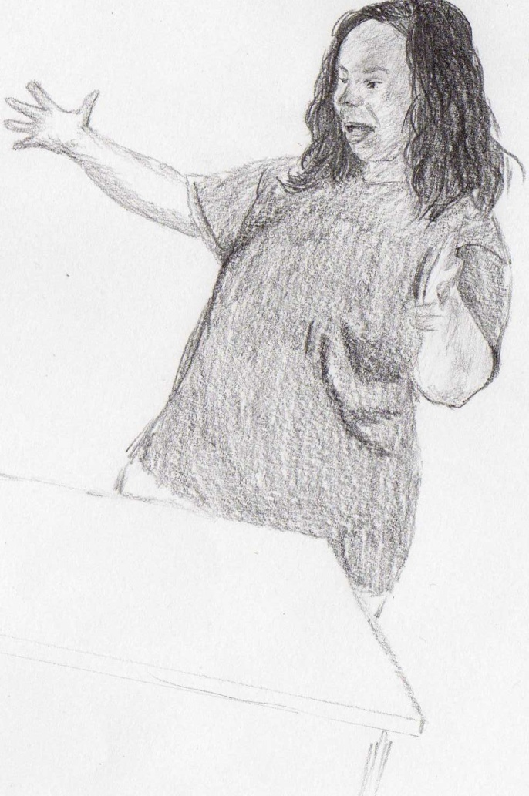
Then he went to his mother, who was really sad and worried about Jack. ‘You don’t have to worry mother! We have enough food now, and we’ll be rich.’ ‘From where? Our only property was the little cow.’ Then he went in to the house, took the hen on the table and said: ‘Lay an egg!’ The hen laid a golden egg for Jack, too. Jacks mom couldn’t say a word because of the big surprise. They kept making the hen lay eggs, until they got rich.

