Slide 1
Jack and the Beanstalk

Slide 2
Jack lived with his mother and they were very poor. They had to sell their cow at the market for money.

Slide 3
While Jack was on his way to the market he met a man and traded his cow for magic beans.

Slide 4
When Jack got home, his mom was angry and threw the beans out the window. The next morning Jack saw a beanstalk!

Slide 5
Jack climbed the beanstalk and saw a large land in the clouds and met a lady who gave him some food.

Slide 6
There was a giant in the great big house and he smelled Jack and said, “Fee-fi-fo-fum!”

Slide 7
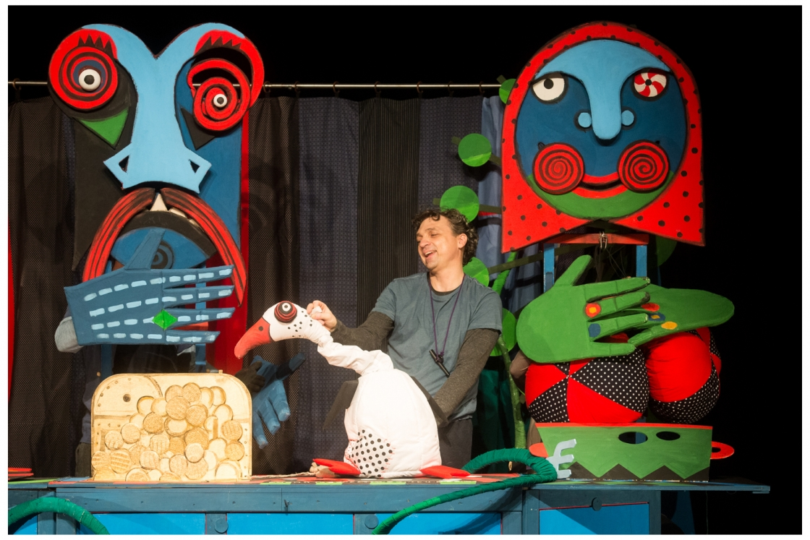
While the giant was asleep, Jack took a bag of gold coins and went home to take them to his mother.

Slide 8
Jack went back up the beanstalk, this time he took a goose that laid golden eggs.

Slide 9
Jack went up the beanstalk one more time and took a golden harp. The harp sang and the giant chased Jack!

Slide 10
Jack went down the beanstalk and asked his mom for an ax. He chopped down the beanstalk. Jack and his mother lived happily ever after.

