Slide 1
Conveying values through folktales Project Week in Vác 2017

Slide 2
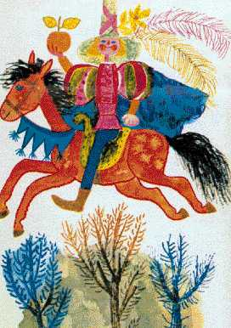
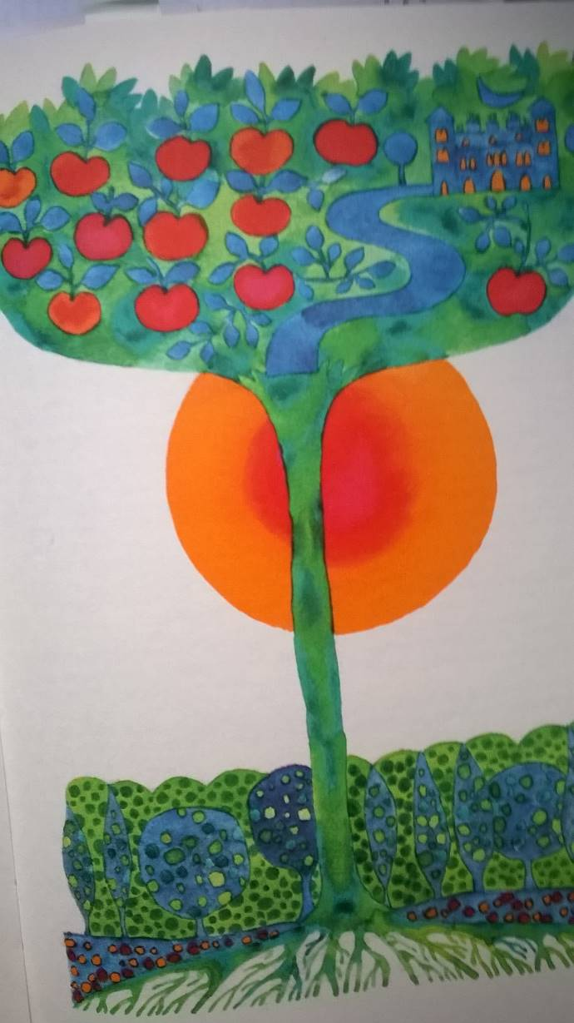
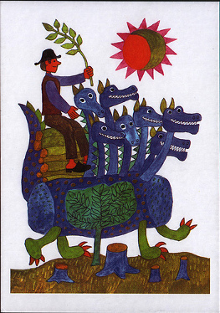

Slide 3
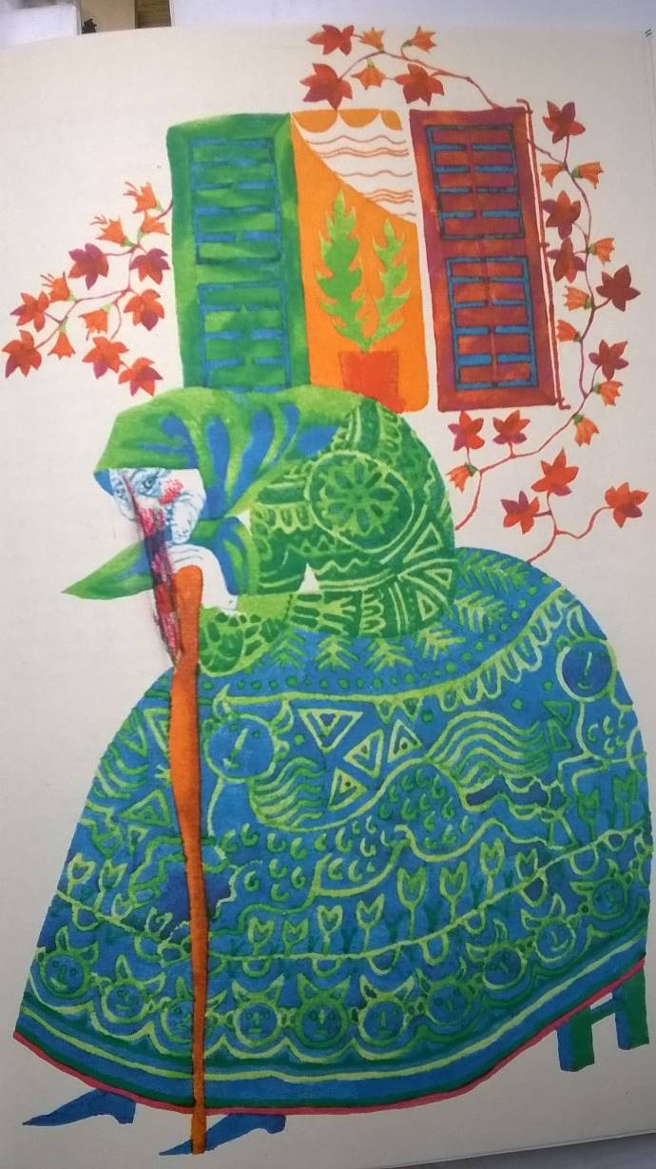
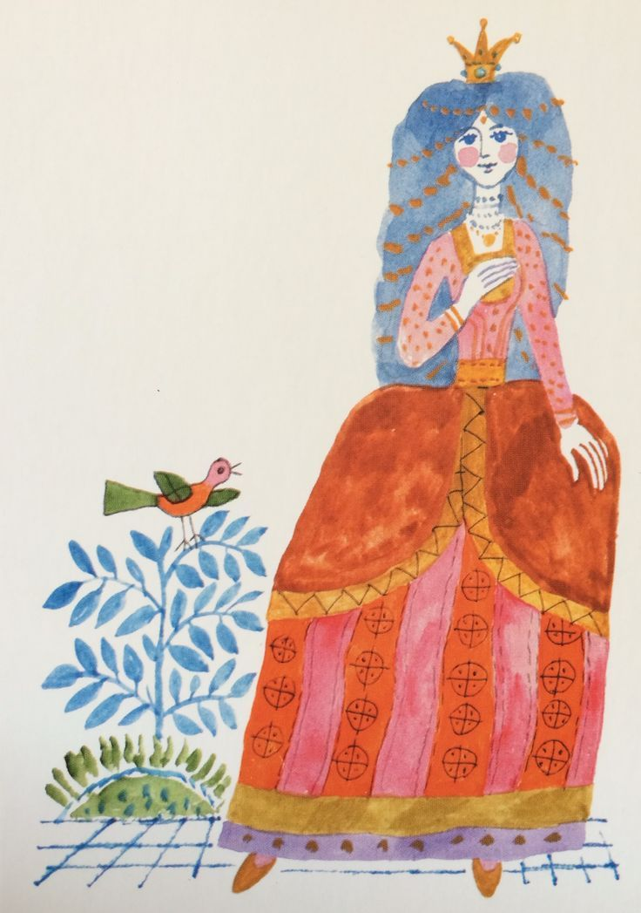

Slide 4
Role of folktales in value transmission Folktales are universal and timeless
Psychological, aspects:
- developing imagination – informal influence – shaping personality
- addressing important existential issues, problems, confronting the child squarely with basic human predicament
- offering solutions, overcoming obstacles is possible
- healing nature: serving as an outlet for expressing formless anxieties and violent fantasies, reading out tales is good
Anthropological aspects:
- universal recurrant themes – folktales are “encoded representations” of tribal rituals addressing the significant moments of transition in human life
- Arnold van Geennep: “rites of passage” – separation, transition, incorporation
Generalizing, abstracted style:
- “abstraction” and “sublimation”, addressing fundamental human experiences at a basic and ‘universal’ level

Slide 5
Role of folktales in value transmission Folktales are not universal and timeless
Paradox:
Folktales represent universal issues, which do not relate to time and place.
BUT: they take different forms at different times in different places, they speak powerfully of the times and places in which they have been told. They are historically bound.
They are effective ways of conveying the knowledge, the values, customs, traditions, the cultural heritage of the previous generations.

Slide 6
Intercultural dialogue Responsibility of educational institutions
To help students become aware of their own roots, cultural heritage, to provide points of reference which allow them to define their own personal place in the world.
To provide students with the necessary theoretical and practical tools so as they can acquire knowledge of the values of other cultures, traditions, and encourage them to open towards people possessing different cultural heritage.

Slide 7
Tale Project Winchester University – Apor Vilmos Catholic College

Slide 8
Research topic of the 1st semester: Formula tales Runaway food type folk tales (Tale type 2025)
Definition: the formula and the variation upon it become the basis of the act of storytelling itself. Plot is spare, functions merely as a basis for developing a narrative pattern, which is repeated (variations, additions)
Advantages, values:
Appeal to young children – simple plot, predictable, repetitive, rhythmical quality
A lot of cultural variants – developing intercultural competence
A lot of creative ways of pedagogical application

Slide 9
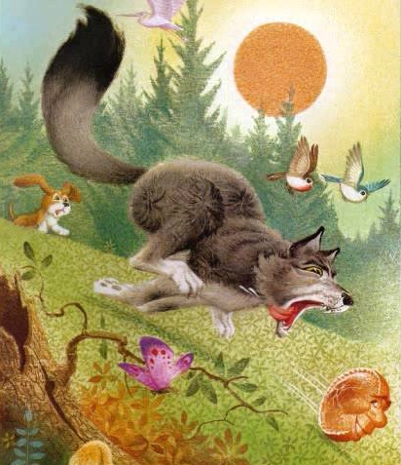
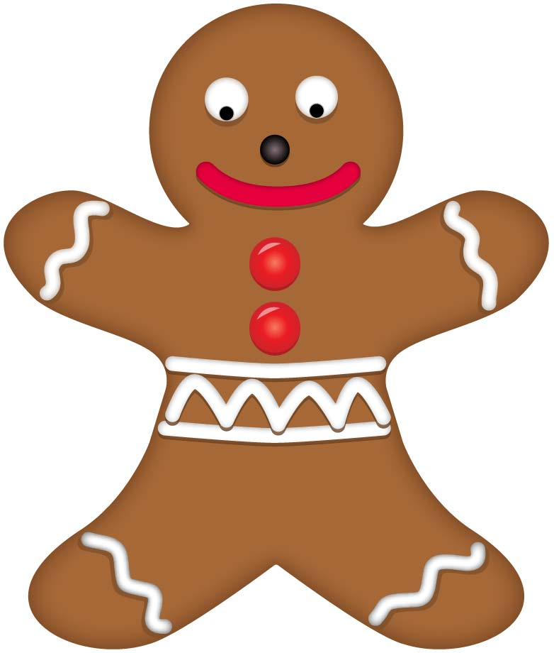
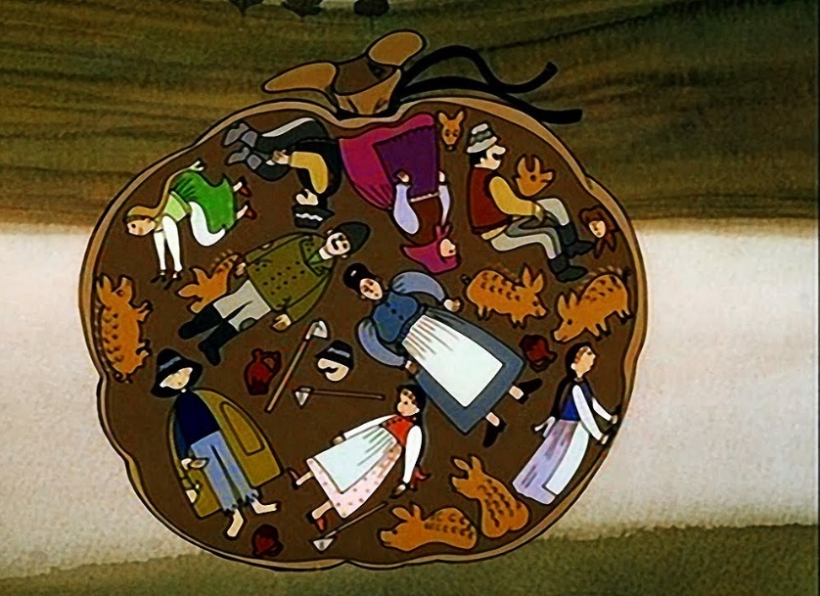
Johnny-Cake British variant Joseph Jacobs: English Fairy Tales, 1890 | The Gingerbread Man American variant first appeared in St. Nicholas magazine in 1875 | The Little Dumpling Hungarian variant László Arany: Hungarian Folk Tales 1862

Slide 10
Comparing three cultural versions of the Runaway food type folktale
Characters
Plot:
The reason for creation
How the runaway food escapes from its creators
How the food is caught, the trick of the captor, and the manner of comsumption
Introductory part
Socio-cultural setting
Meaning
Food: recipe
Language patterns
Formulaic opening and closing phrases
Formulaic rhymes

Slide 11
Research topic of the 2nd semester: Jack and the Beanstalk Storytelling based on pictures about the Jack and the Beanstalk puppet performance in Kabóca Puppet Theatre

Slide 12
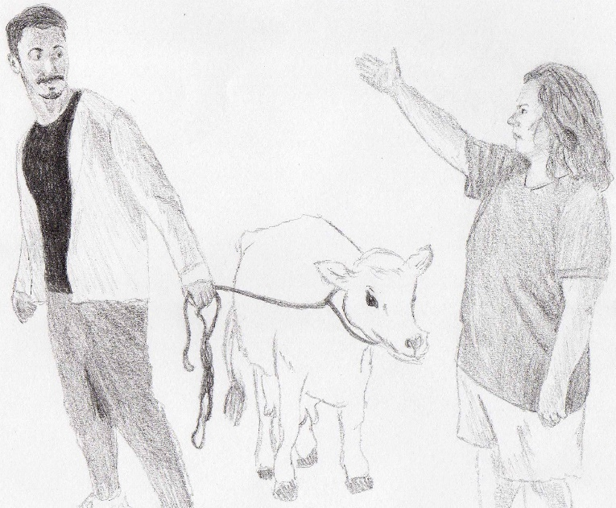
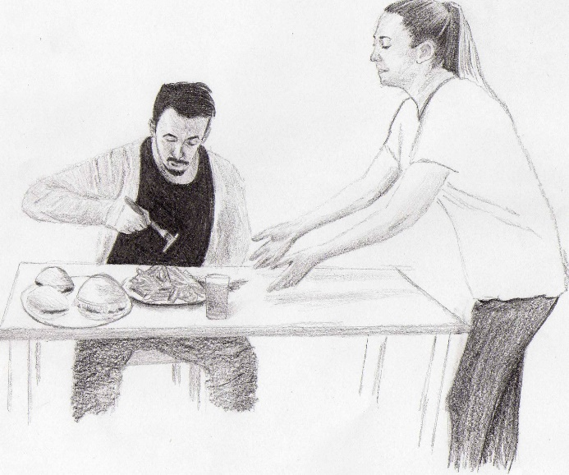
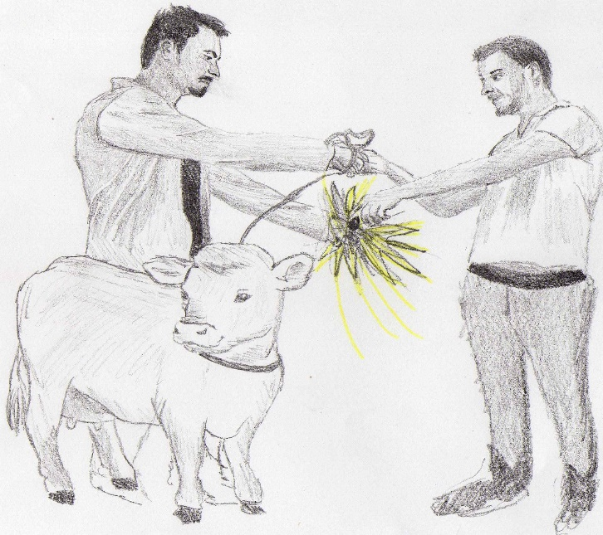
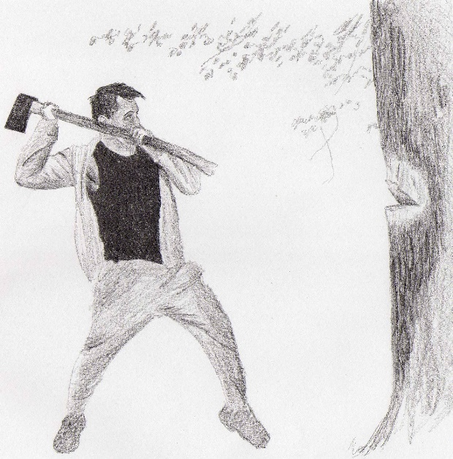
Jack and the Beanstalk: comic book adaptation

Slide 13
Schoolwork 1) Digital storytelling: iPad animation using Lego characters 2) Life-size storymap 3) Telling the story creating a picture string

Slide 14
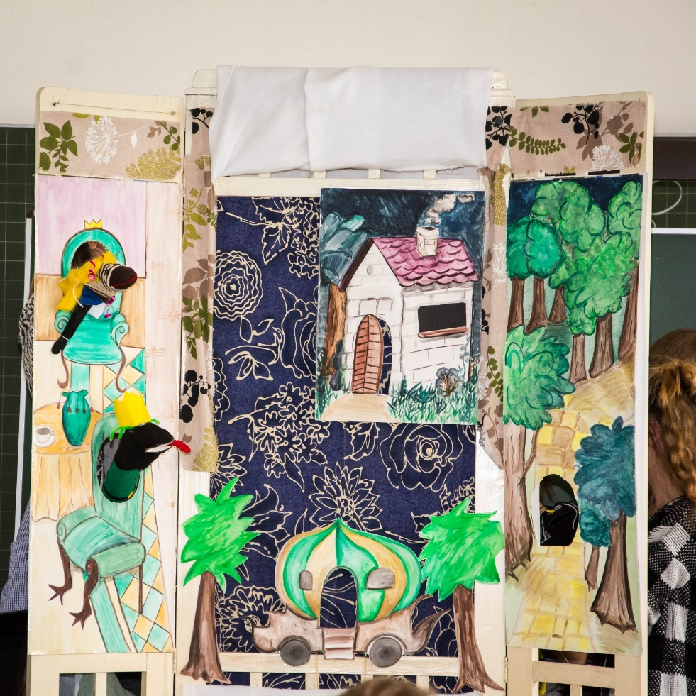
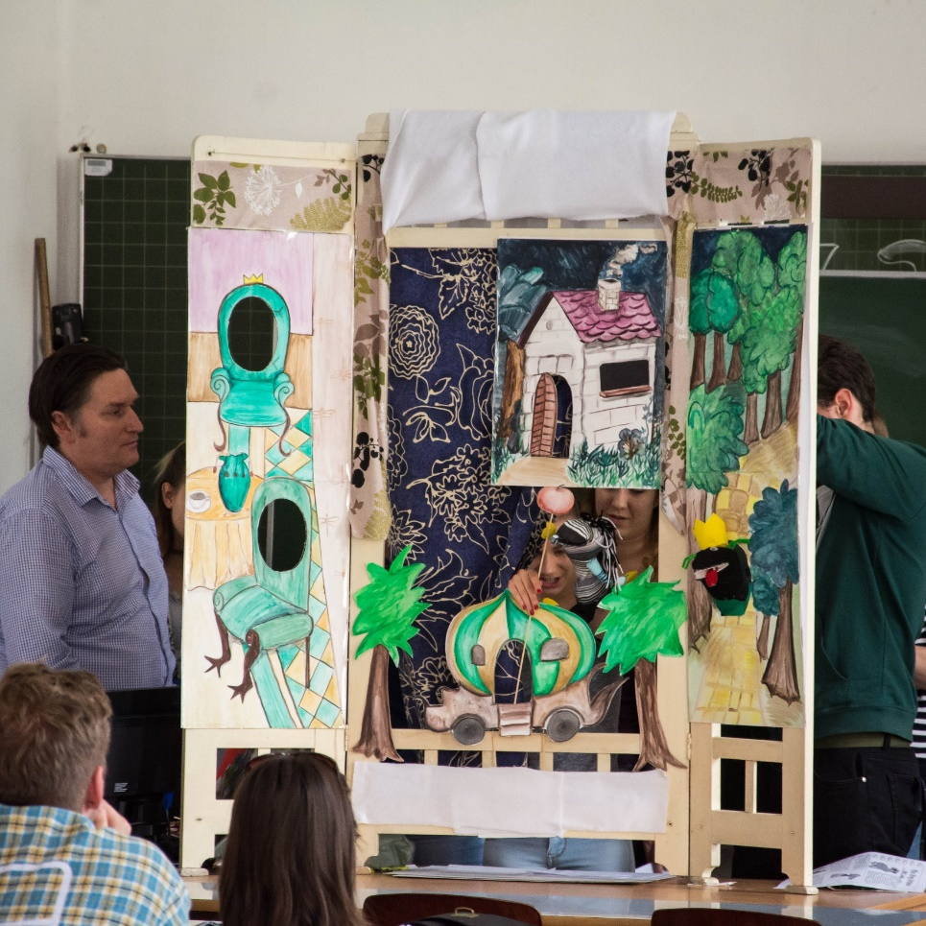
Puppetshow-parody of a classic fairy tale The Frog Prince

Slide 15
Thank you for your attention!

