Slide 1
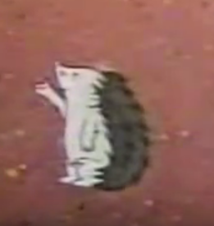
The Hedgehog, the Merchant, the King and the Poor Man A Hungarian Folktale
Setting
Most folktale settings remove the tale from the real world, and they are described in vague terms. Yet, in a way, they reflect the typical landscape of the tale’s culture, e. g. medieval Europe with its forests, castles, and cottages.

Slide 2
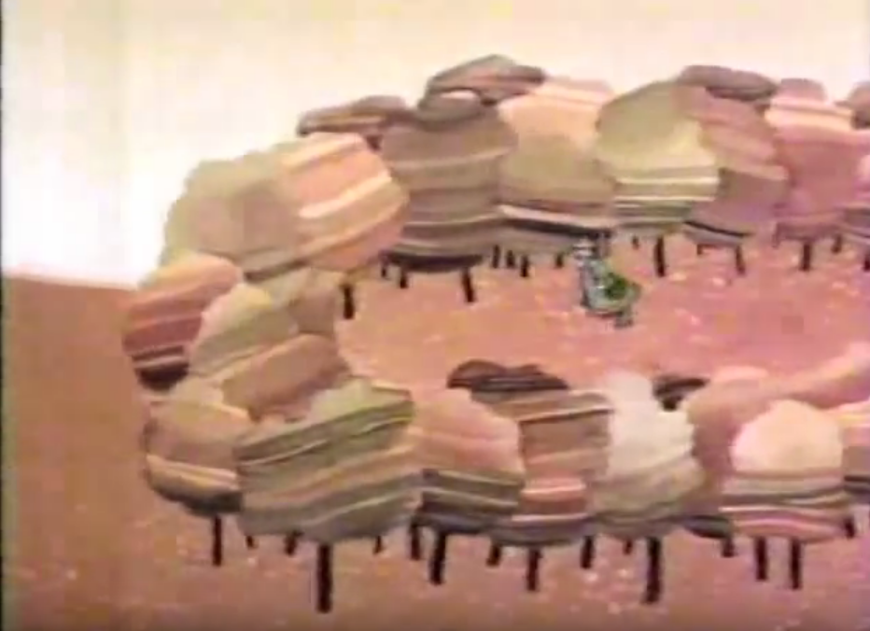
Comparison of the tale text and the cartoon by Marcell Jankovics The forest
In the text: The forest is a ‘great wild thicket’, where the characters can see ‘neither the sky nor the earth’. They are just ’groping and stumbling around like a blind man’. It is a mysterious place.
In the cartoon: There are a lot of trees where you can get easily lost. The ground is bleak, and although there is a clearing, the three Elders (the King, the Merchant, and the Poor Man) can’t get out.

Slide 3
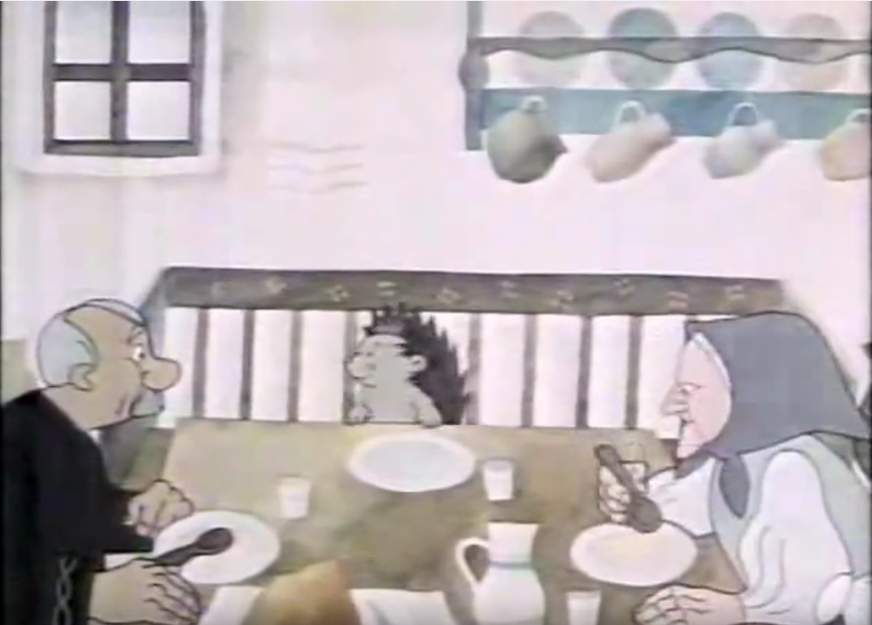
The poor man’s house
In the text: There is a stove, where the poor man is lying when the Hedgehog arrives. First he gives the hedgehog food on a wooden plate under a bench by the fire. Then he seats his adopted son at his side, and puts a tin plate before him.
In the cartoon: We can’t see many items in the house. There is a small window without a curtain. The poor man and his wife are sleeping in a big „towering” bed and there is a candle standing by it. In the kitchen we can see a big dining table with a bench behind it. The characters are eating with wooden spoons. There are a lot of jugs on the wall.

Slide 4
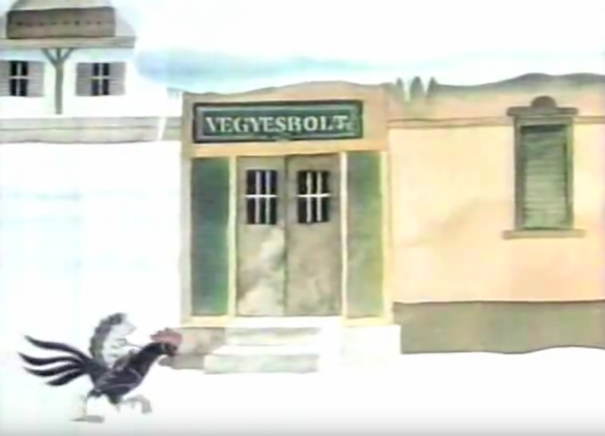
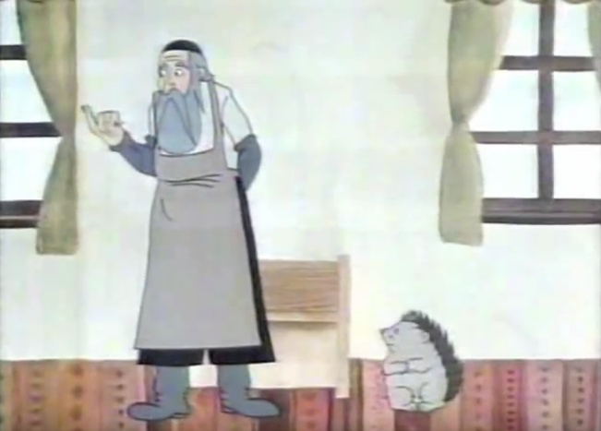
The shopkeeper’s house
In the text: We know that there is a gate belonging to the shopkeeper’s house. The shopkeeper calls his three daughters into the „white chamber”. He seats his daughter in a ‘coach , to which four horses were attached.’
In the cartoon: The shopkeeper’s house is big, outside, the walls are of orange colour, with green windows. The yard is covered up with snow, and there is a dog, too. Inside the house we can see a spacious room , two big windows with light green courtains and a small storage press. There is only one horse attached to the coach.

Slide 5
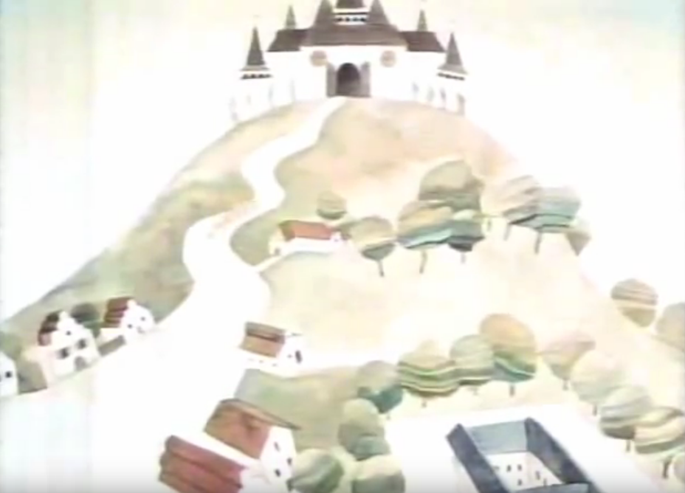
The King’s castle
In the text: The King calls his three daughters into the „white chamber”, and seats his daughter into a ‘chariot with gold and glass’.
In the cartoon: The castle is on the top of the hill. The king is sitting on a big throne decorated with motifs of Hungarian folk culture. There are six horses attached to the chariot.

Slide 6
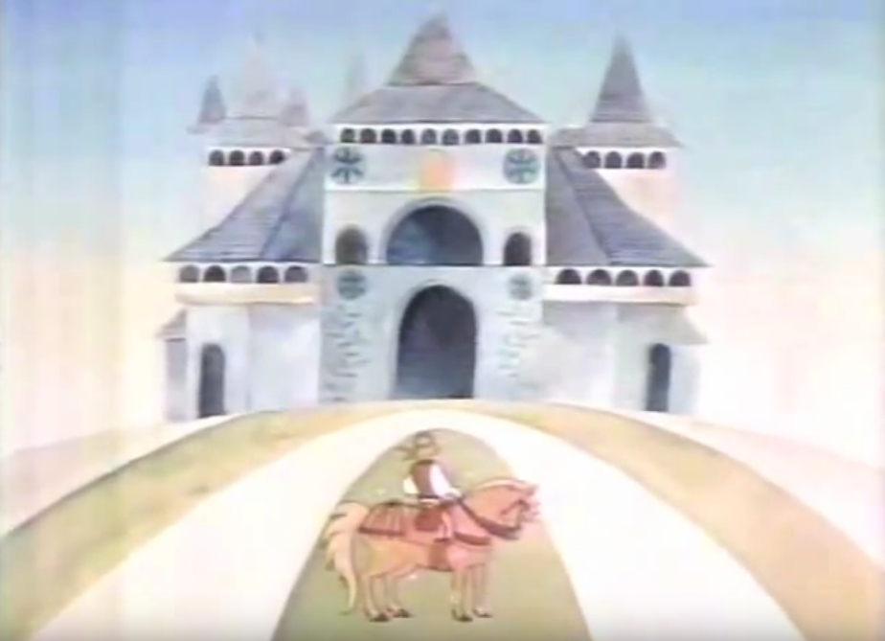
The Palace of the Young Couple
In the text: The palace is a ‘copper-roofed marble palace, turning on a cock’s foot’. It is a ‘pearl-given palace’.
In the cartoon: Big, sparkling palace with diamond walls and diamond windows.

