Slide 1
Folk fairy tale trip to Hungary
An English language exchange trip to analyse traditional folk fairy tales, in addition to discussing and experiencing the differences between the English and Hungarian school systems.

Slide 2
Aims
Website
Select Fairy Tale
Develop pedagogic approach
Experiment in school in early January

Slide 3
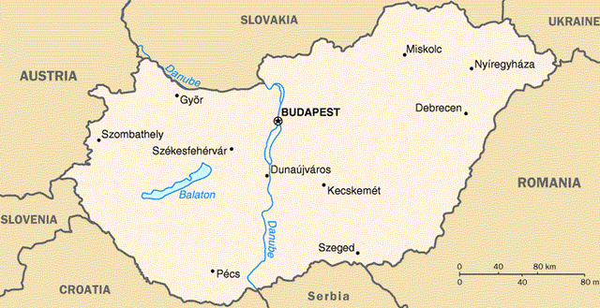
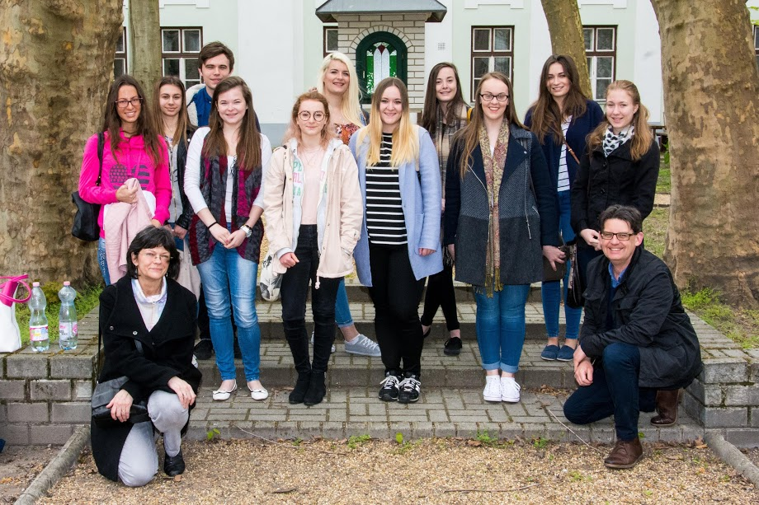
About the trip
In April 2016, seven English Language specialists travelled to Vac, Hungary (red circle on map) to partake in a Folk Fairy Tale project. We stayed at Apor Vilmos Catholic College, a teacher training college in Vac, where we not only experienced life as Hungarian students, but we were also given the opportunity to teach in multiple primary schools. In addition to this we also gave presentations and taught workshops to the Hungarian university students.
The main aim of the project was to complete a comparative study between the traditional folk fairy tales popular in each country. We analysed and discussed the key themes, motifs and characters in our varying folk fairy tales, and planned a lesson which we took into both English and Hungarian primary schools in order to create a comparison.

Slide 4
The project
Whilst in England, we spent time analysing a multitude of traditional English and Hungarian folk fairy tales. Our aim was to develop a keen knowledge of the similarities and differences between the tales, as well as discover how they could be a beneficial teaching aid in school.
After planning and teaching a successful lesson in England, we travelled to Hungary to teach a similar lesson, adapted slightly to compensate for the language barrier. We used the same lesson plan which was based on a Hungarian folk tale, and incorporated a range of typical English teaching strategies, such as the use of technology, in order to form a fair comparison between our two teaching experiences.

Slide 5
The project
After observing an experienced practitioner teaching an English language lesson to Hungarian students, we concluded that current teaching methods in Hungary are similar to traditional teaching methods in England. With the children sat at individual desks set out in rows, there was little discussion or group work incorporated into the lesson.
Whilst teaching our own lesson therefore, the pupils were initially unsure of how to react, however the opportunity to use iPads to support their learning was of great interest, and they were soon engaged with their task.

Slide 6
The Experience
Personally, we found the experience of not only observing, but teaching in a Hungarian primary school an invaluable one. We had no choice but to adapt our original lesson plan, and be flexible practitioners when faced with 30 pupils who spoke very little English.
Additionally, having the opportunity to share our own knowledge and experiences with other university students, and share ideas for our practice has proved extremely useful. Introducing technology to the students, many of whom had never used an iPad before, gave them new innovative ideas which they could adapt to use on the technology which was available to them. Alternatively, we saw how technology is not always the most affective method of capturing children’s interest, with drama, music and puppetry being three key themes at the heart of Hungarian teaching.

Slide 7
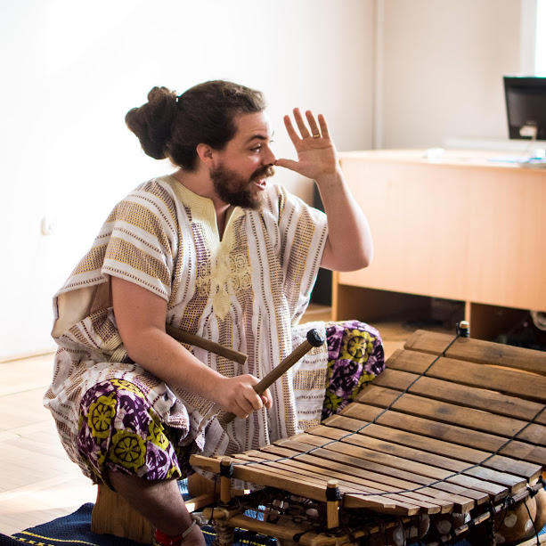
Not all work
During our trip to Hungary, we also had free time to explore the country, as well as partaking in activities organised by the university. The Hungarian students who hosted us during our visit were extremely talented when it came to music and theatre, putting on performances and teaching us about the benefits of incorporating drama in teaching.
We also had time to explore Vac, as well as several trips to Budapest with the university students. During one of these trips we went to a small story museum which was a definite highlight for out group. With each room symbolising a different part of a classic Hungarian folk tale, we were taken on a sensory trail throughout the story, offering multiple ideas for our own teaching.
Another favourite part was a visit from an American musician, Danny Bain, who performed The Gingerbread Man, (linked below).
https://www.youtube.com/watch?v=L4jGDKRcuSM

Slide 8
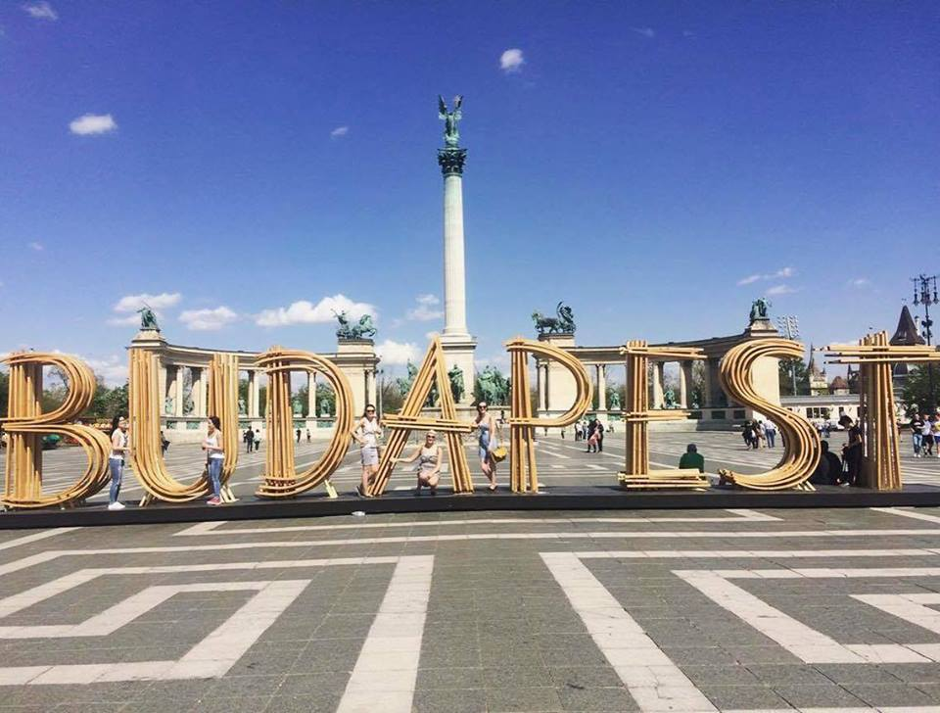
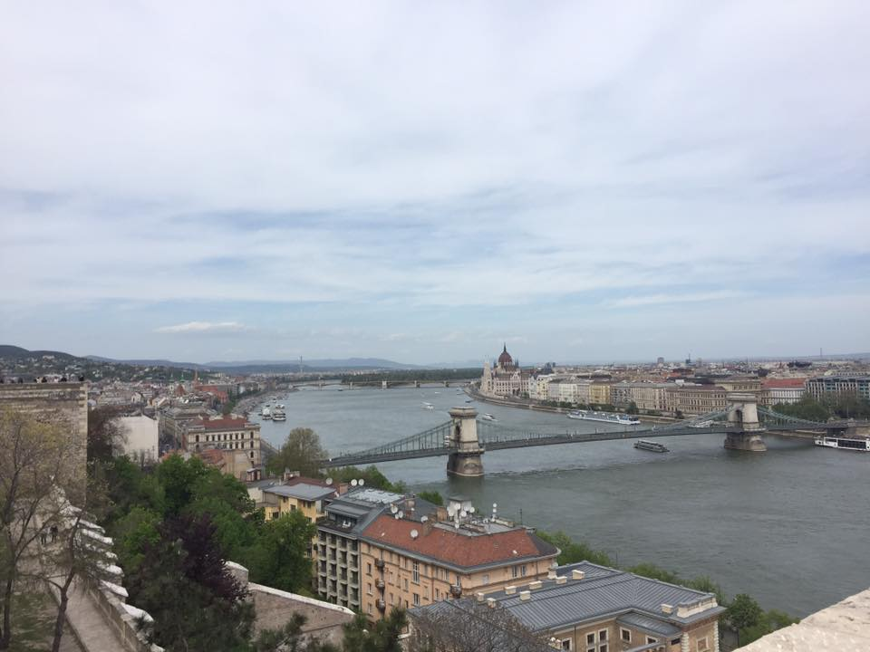
Share the experience
If you are given the opportunity to go on a trip such as this one, we would highly recommend you do it! Not only will it be useful for your future career, but it is also an opportunity to go to another country and get involved with activities and experiences which may not otherwise be available.
Of course, teaching in another country will look good on your CV, but there are so many other reasons as to why you should seriously consider going on an exchange trip whilst at university. As a group, we stayed in Budapest after our week at the university to continue exploring the amazing city, with two of us continuing our travels to Vienna, Prague and Amsterdam. Without the help of the university, and our week with Apor Vilmos Catholic College, none of us would have had the same opportunities, nor made the friends and memories that we have come away with.

Slide 9
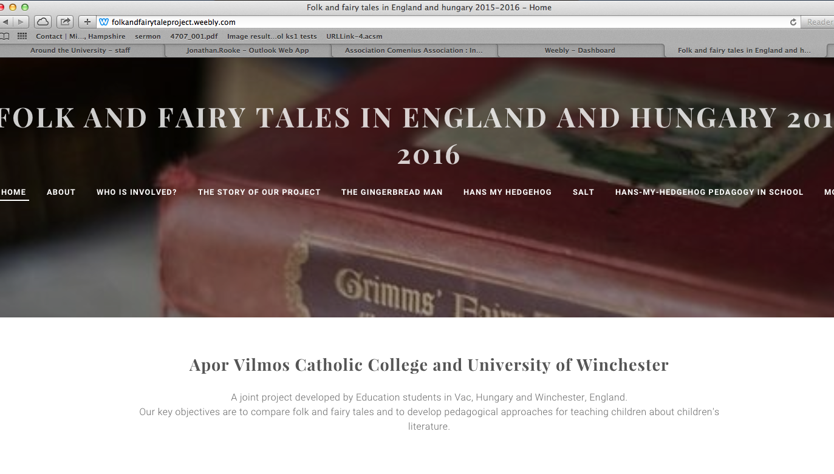
http://folkandfairytaleproject.weebly.com

