Slide 1
Folk tales of the runaway food type

Slide 2
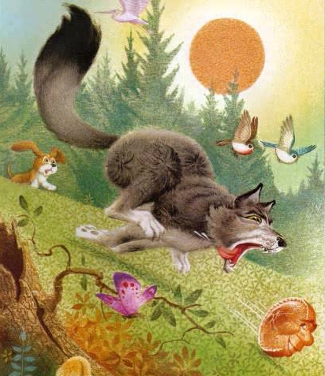
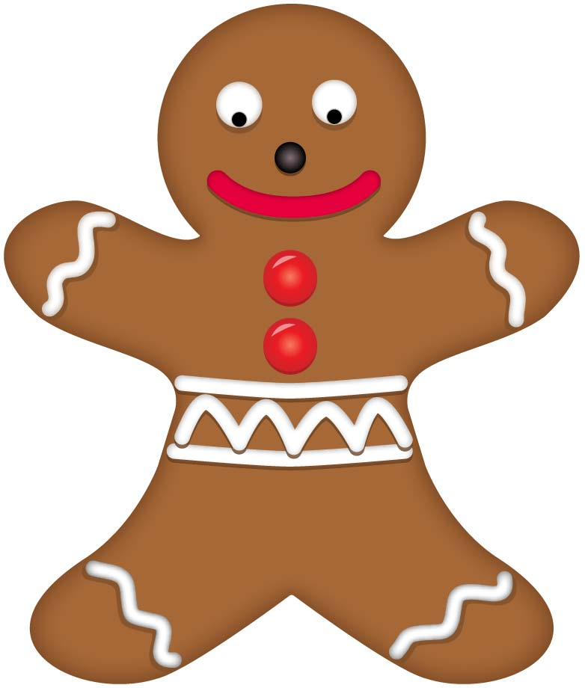
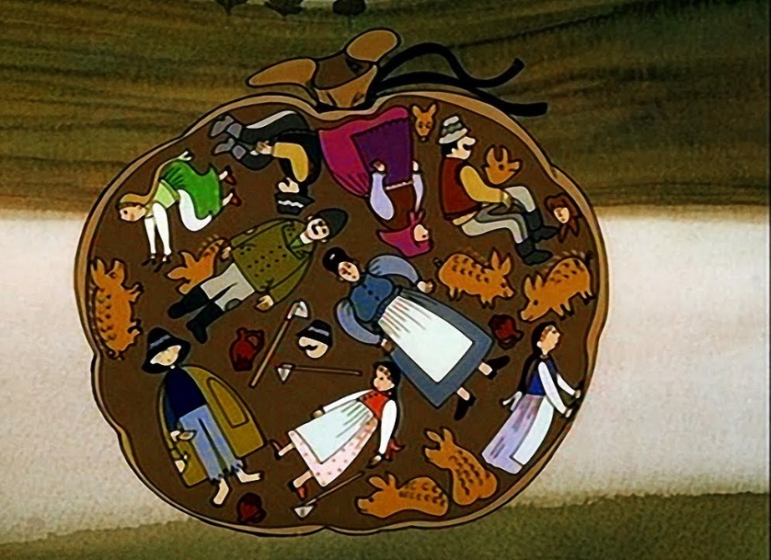
Johnny-Cake British variant Joseph Jacobs: English Fairy Tales, 1890 | The Gingerbread Man American variant first appeared in St. Nicholas magazine in 1875 | The Little Dumpling Hungarian variant László Arany: Hungarian Folk Tales 1862

Slide 3
Characters
Johnny-Cake Old man Old woman Little boy Johnny-cake Two well-diggers Two ditch-diggers Bear Wolf Fox | The Gingerbread Man Old woman Gingerbread Man Cow Horse Goat Fox | The Little Dumpling Poor man His wife Three daughters The little dumpling Scythemen Soldiers Pig

Slide 4
Plot
Johnny-Cake The old woman bakes him. He jumps out of the oven. He runs away from everybody. Fox screws him and eats him up. Everybody wants to eat him up. | The Gingerbread Man The old woman bakes him. He jumps out of the oven. He runs away from everybody. Fox screws him and eats him up. Everybody wants to eat him up. | The little dumpling The family has to kill the pig and hangs it from a rope in the attic. The dumpling eats them up, but the rope can’t hold it anymore. It rolls down the road eats everybody up. A coach tramples down it and all the people pour out. It wants to eat everybody.

Slide 5
Spot
Johnny-Cake Garden Road Roadside A corner of the fence | The Gingerbread Man House Road River | The Little Dumpling Attic Road Bridge

Slide 6
Language patterns
Johnny-Cake Once upon a time… „Where are you going, Johnny- cake?” “I’ve outrun an old man, and an old woman, ... and I can outrun you too-o-o!” „You can, can’t you? We’ll see about that?” | The Gingerbread Man One day… „Run, run as fast as you can. You can’t catch me, I’m the gingerbread man.” „Stop I want to eat you.” | The Little Dumpling „Yumm, I’ll eat you up!” „If it had not ripped open, this story would have gone on for much longer, too.”

Slide 7
Activity plan The Gingerbread Man
Age: 5-6 year-old children
Aims: To experience food from a different culture, to develop fine motor skills, eye-hand coordination, to follow instructions, to develop concentration and memory skills through following a story, to prepare and act out a story, to collaborate with others, to apply the methods of Total Physical Response
Language focus: food vocabulary, animal vocabulary, Simple Past Tense, verbs like walk, run, jump, hop
Materials: Essential: pictures of the characters, an oven, a river, a gingerbread man puppet Optional: gingerbread man biscuit mixture, headbands

Slide 8
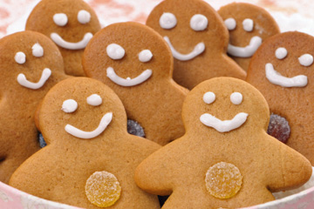
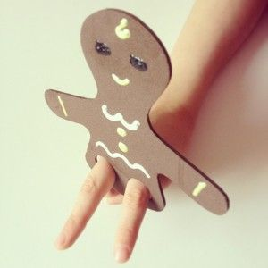
Activity plan The Gingerbread Man
Procedure:
Preparation: Bake gingerbread man biscuits, and prepare a gingerbread man puppet at home. Read the story in advance and practise telling it.
In the activity room: Give the children their gingerbread men to eat.

Slide 9
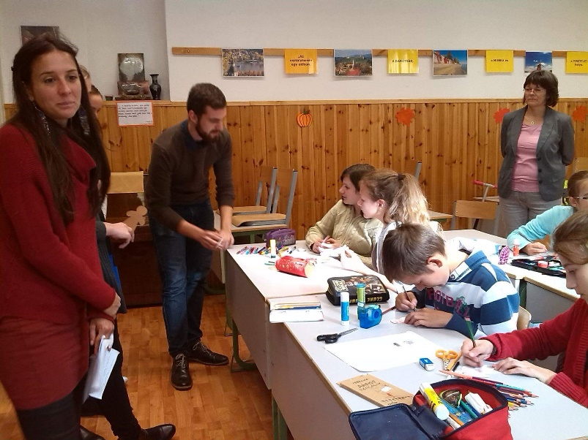
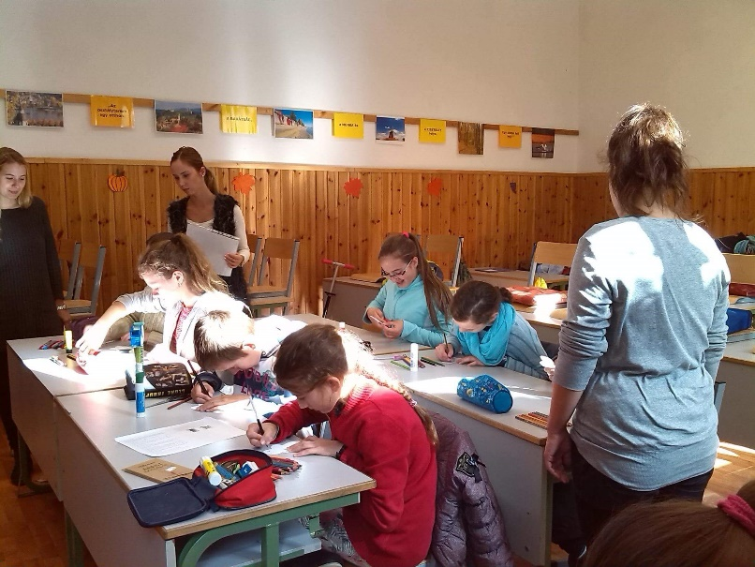
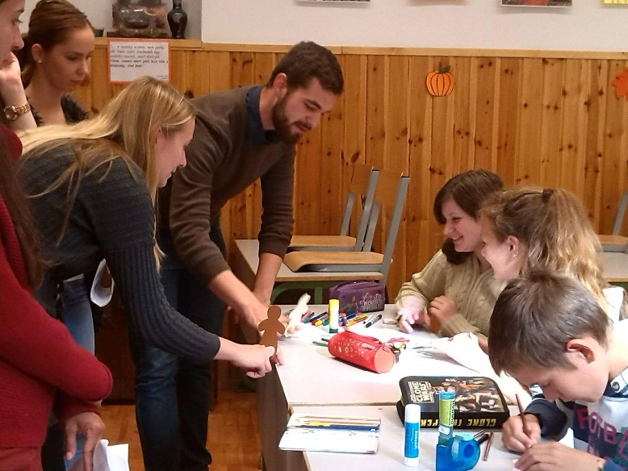
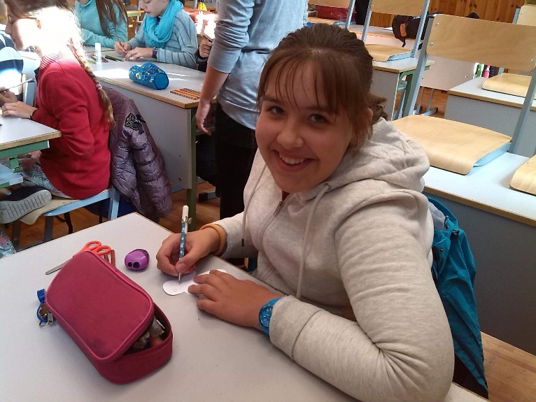
Activity plan The Gingerbread Man
Art and craft activity: Get the children to make gingerbread man puppets so that they can use them while you are telling the story. Using your puppet, show the children that he can walk, run, jump and hop. Encourage the children to make their puppets do the actions.

Slide 10
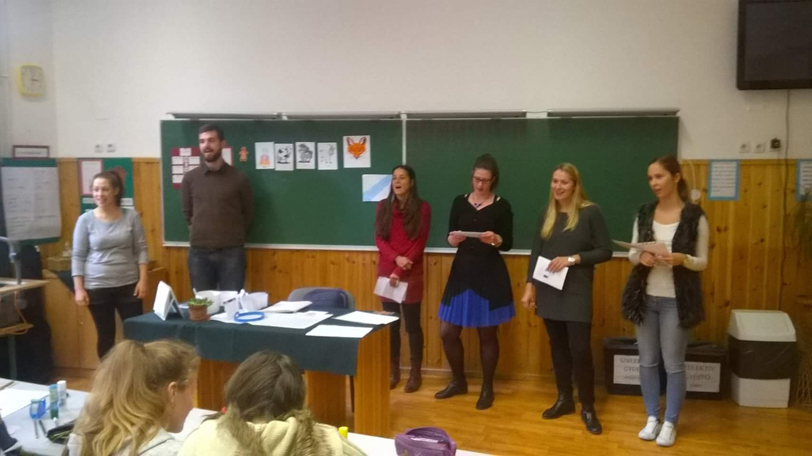
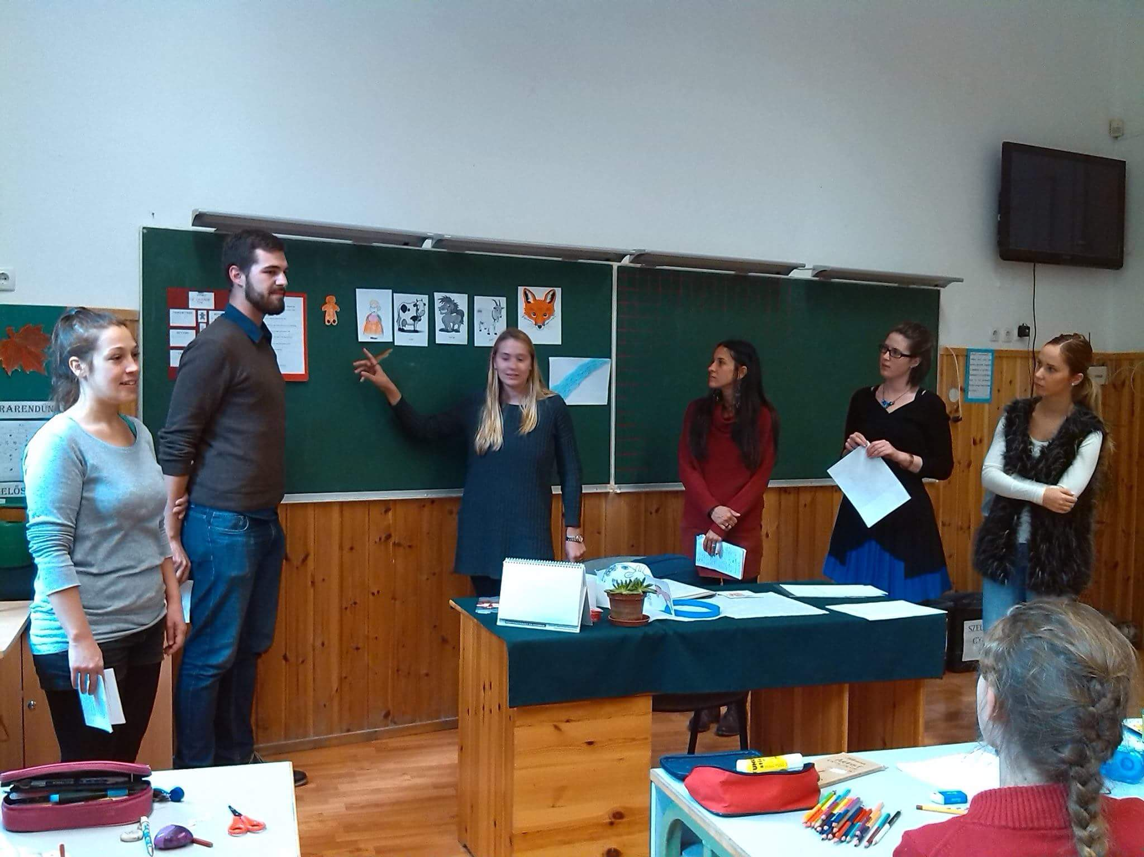
Activity plan The Gingerbread Man
Show the children the pictures of the characters in the story and try to elicit the names in English. Stick the pictures on the board in the appropriate order: old woman, cow, horse, goat, fox. Tell the story using your gingerbread man puppet and pointing to the characters. Tell the story several times to the children.

Slide 11
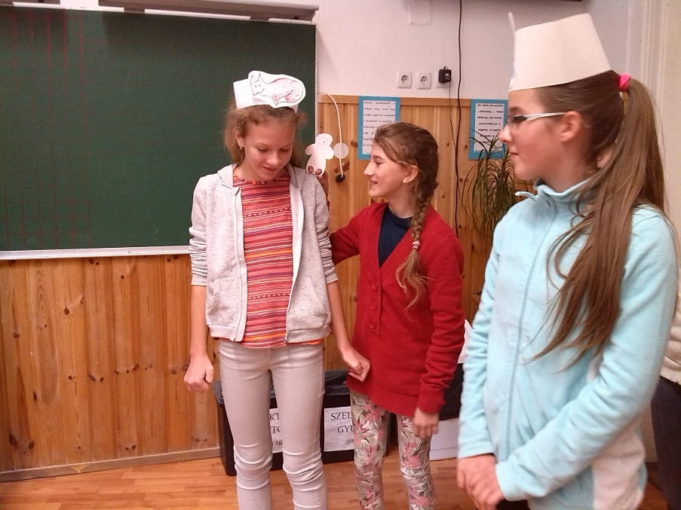
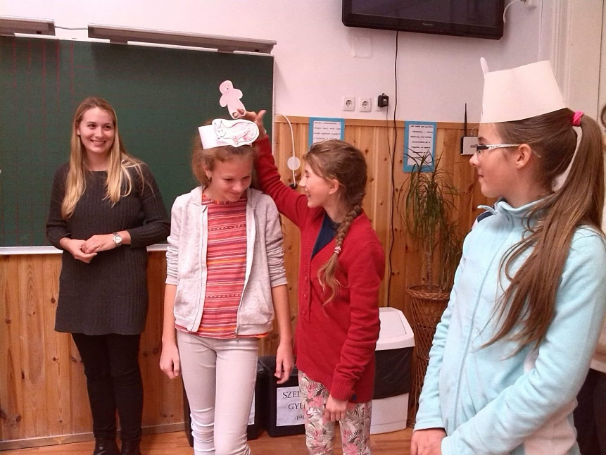
Activity plan The Gingerbread Man
Dramatizing the story: Give out the roles and perform the story with the children. Get them to do the actions, to imitate the gestures. Practise it a lot.
Get the children to learn their roles and say their lines as well. Have all the children say the sentences “Run, run as fast as you can. You can’t catch me I’m the gingerbread man.” in chorus.
https://www.youtube.com/watch?v=W9FZ4C0iAwM&sns=em

Slide 12
Thank you for your attention!

